Slide 1

Data Scientist til forretningsudvikling
Interview 2
Hossain Morshed

Slide 2
We have two data table. Goal is to find insight from the existence data.
Data table are :
1) Sagsbehandlings data table
2) Tidsregisterings data
We try to find the Answer of the following question
How much money do we need to collect in total?
How many cases do we need to work on?
How many cases we did?
How much money did we collect?
How much money that we need to refund?
Who is responsible to collect most of the money
Which kind of control mostly need to be done.
Etc………

Slide 3
We will go through Different stage of data analysis for this purpose
For example:
For this purpose, we use Data analysis Package R
Loading the data into R and Clean the data
Perform exploratory data analysis (EDA).
Select, build, and test models.
Deploy models.
Monitor and validate against stated objectives

Slide 4
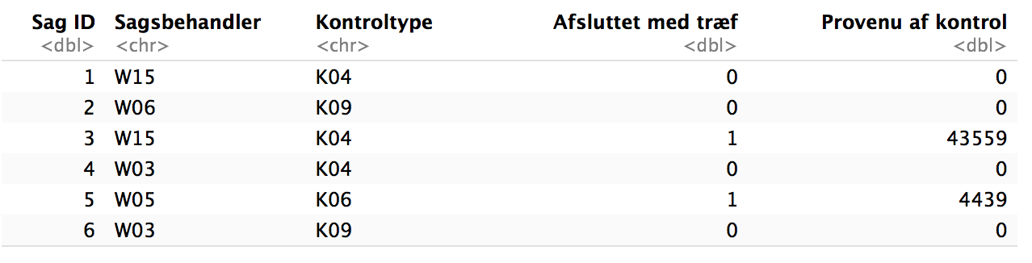
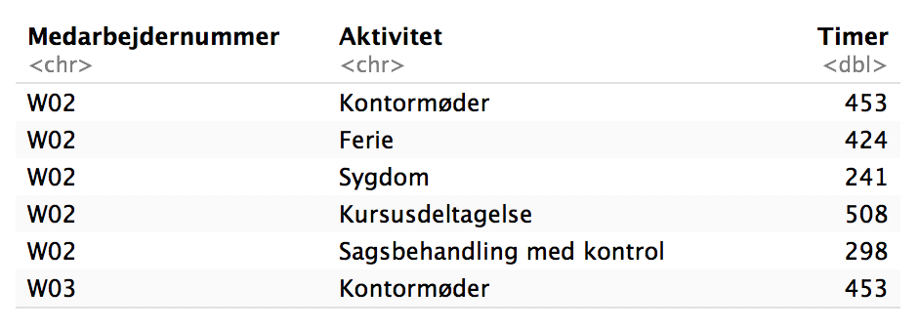
Sagsbehandlings data
Tidsregisterings data
We don’t have any missing value in any of the table

Slide 5
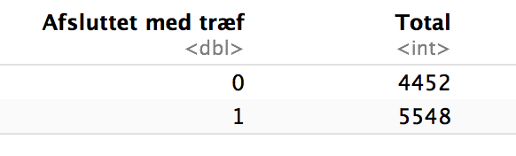
Total number of control is 10000
Total number of control which is completed 4452
Total number of control which is not completed 5548

Slide 6
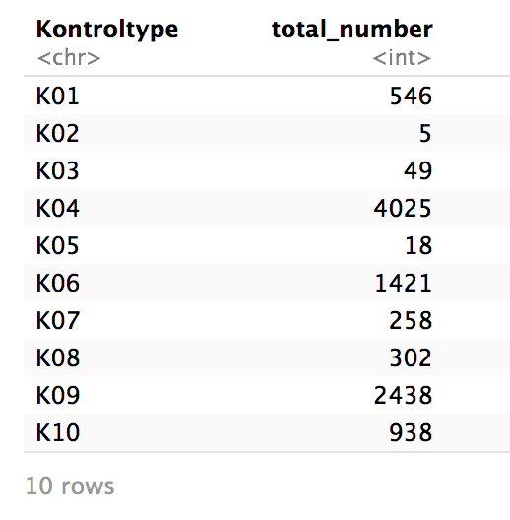
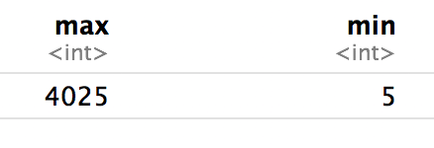
Total number of each control
- we have 10 different type of control
- k04 type of control repeated most which is 4025 times
- k02 type of control repeated less which is only 5 times

Slide 7
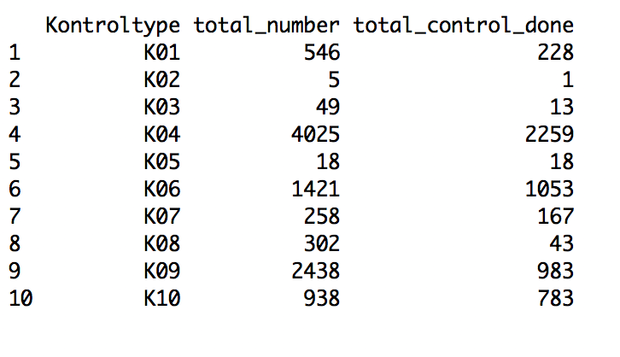
below chart show total number of control and how many of them are done

Slide 8
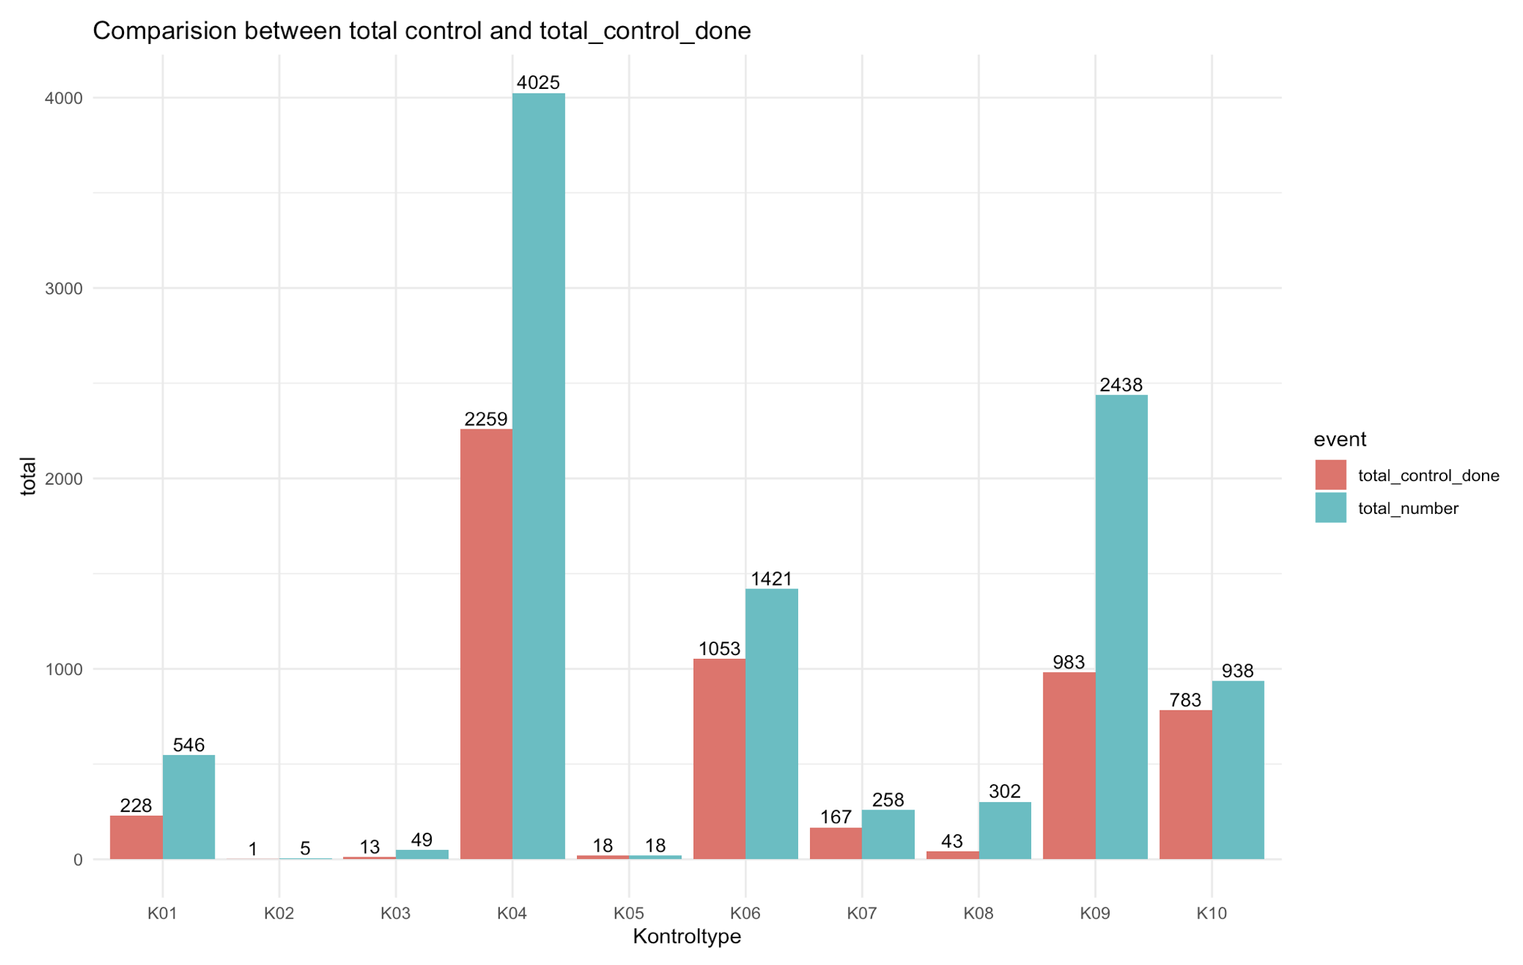

Slide 9
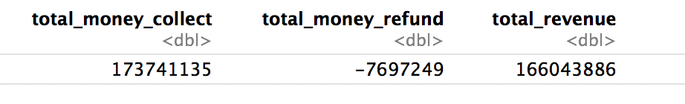
Total Revenue
Total money need to collect is 173741135
Total money need to refund is 7697249
Total Revenue is 166043886

Slide 10
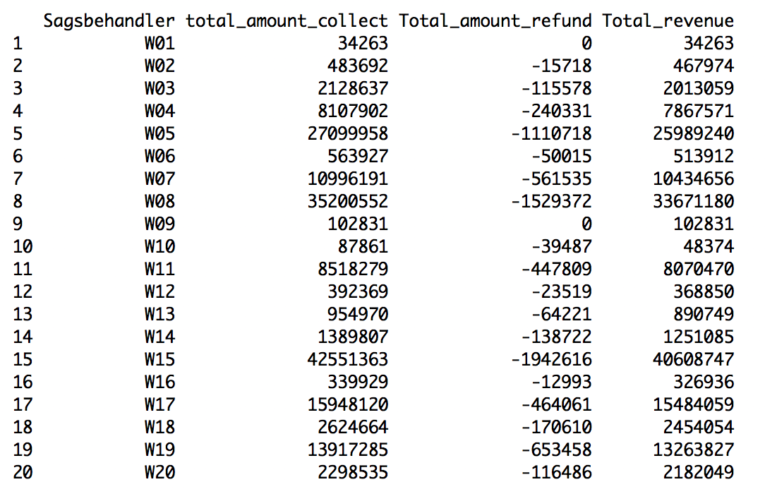
Each case office and total amount of money to collect
Total amount of money each case officer must collect, refund and finally total revenue

Slide 11
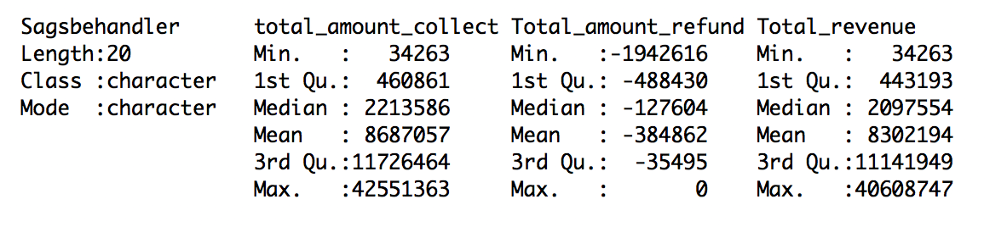
Employee who must collect most of the money
we categories top case worker based on mean and median value
Mean of total amount a case worker must collect is 8687057
Median of total amount a case worker must collect is 2213586

Slide 12
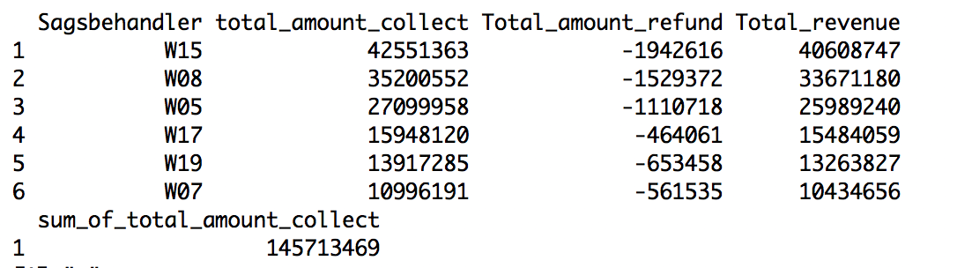
Top case worker who falls above mean value.
we can see that total 6 case worker fall above the mean line. and they must collect total 145713469 out of 173741135 which is 83.86815 %
Question: What makes 6 caseworkers are responsible to collect 84% of the total revenue?
We will try to see what is the reasoned this 6-case worker is responsible for 84% of the total revenue.

Slide 13
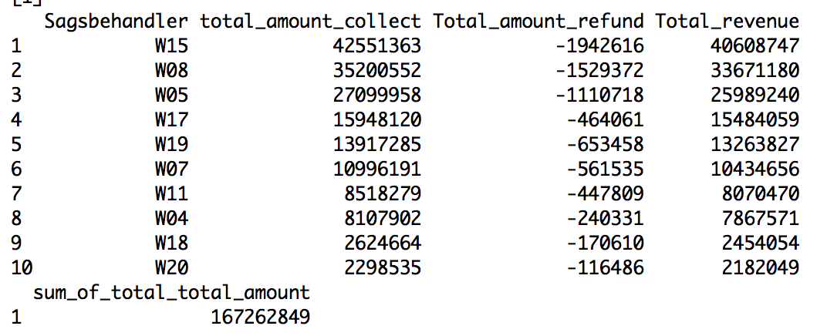
we can see that total 10 case worker fall above the median line. and they must collect total 167262849 out of 173741135 which is 96.2713 %

Slide 14
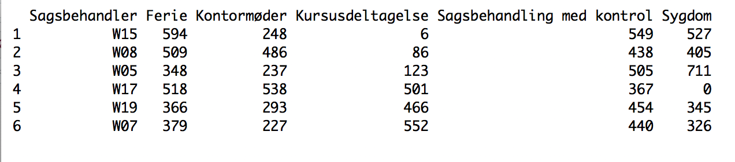
From Employee timetable we separate Top 6 employee timetable:

Slide 15
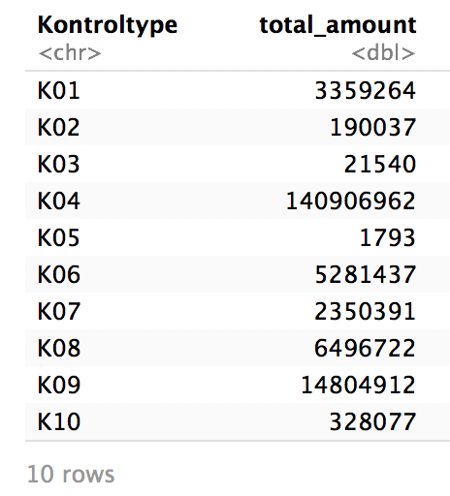
Each control type and total amount of money
- below table show each control type and total amount of money need to collect.

Slide 16
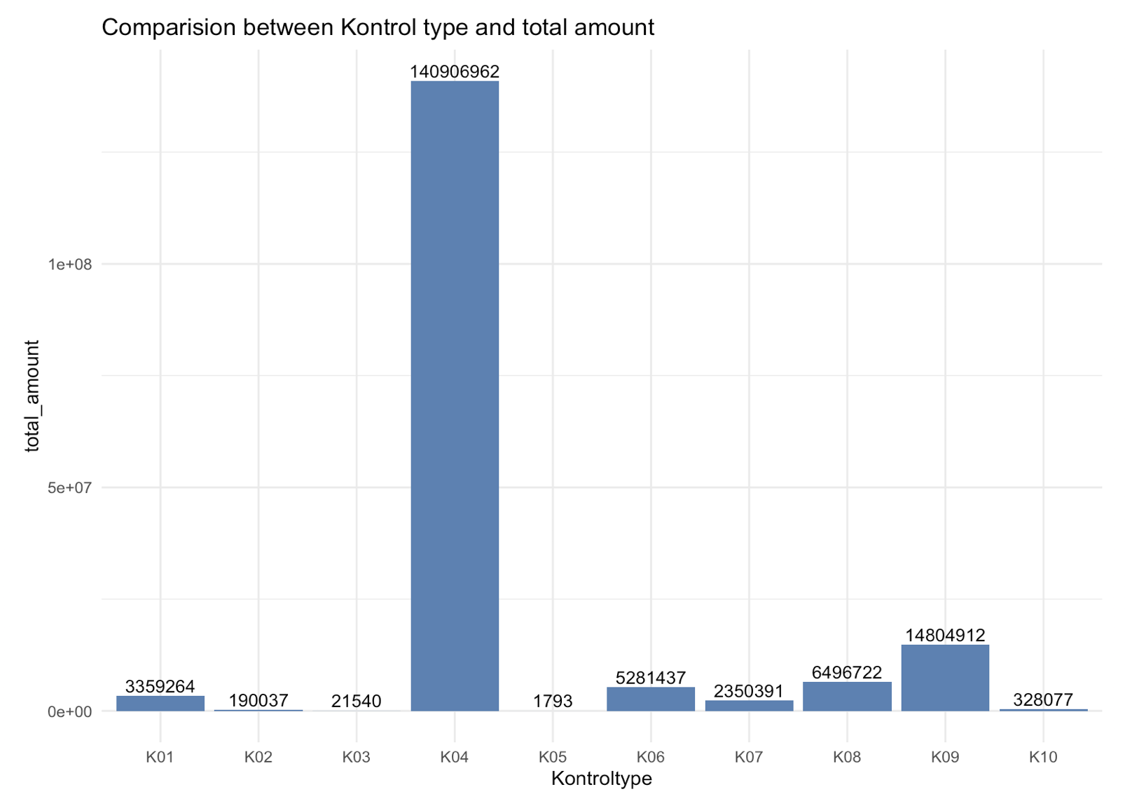
comparision total amount and each type of control
- we can see that most amount of money we need to collect is k04 type of control.

Slide 17
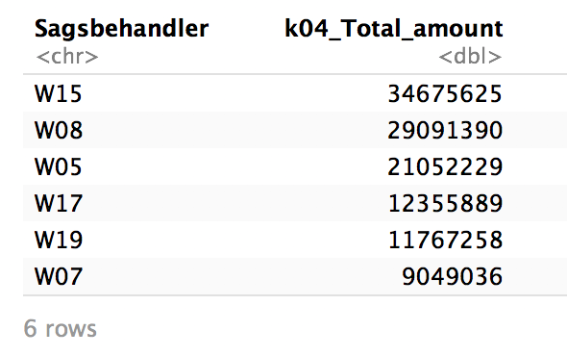
The top employee who falls above the mean line of k04 control.
We can see that these are same employee who also responsible for 84% or revenue.

Slide 18
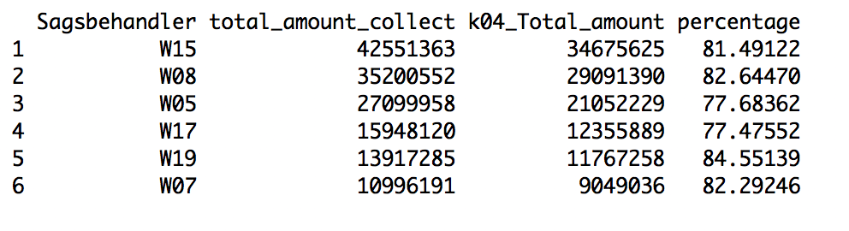
Case worker k04 control total amount compared to total amount the must collect

Slide 19
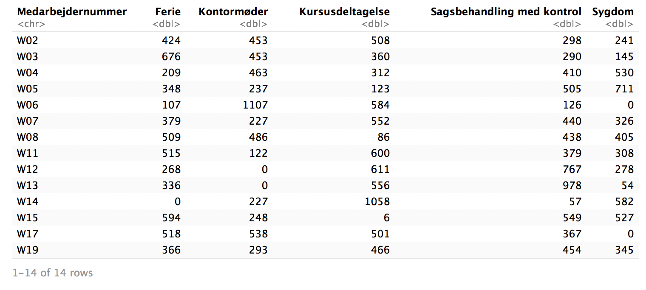
Case worker different activity timetable

Slide 20
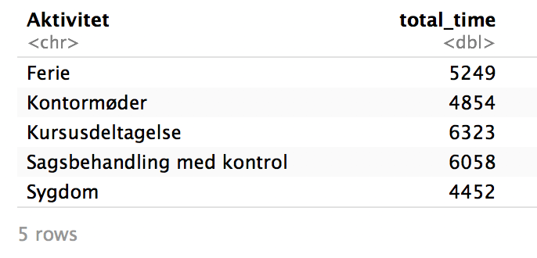
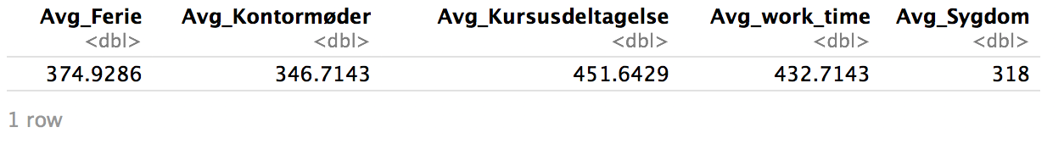
Total time spend by employee in different activities

Slide 21
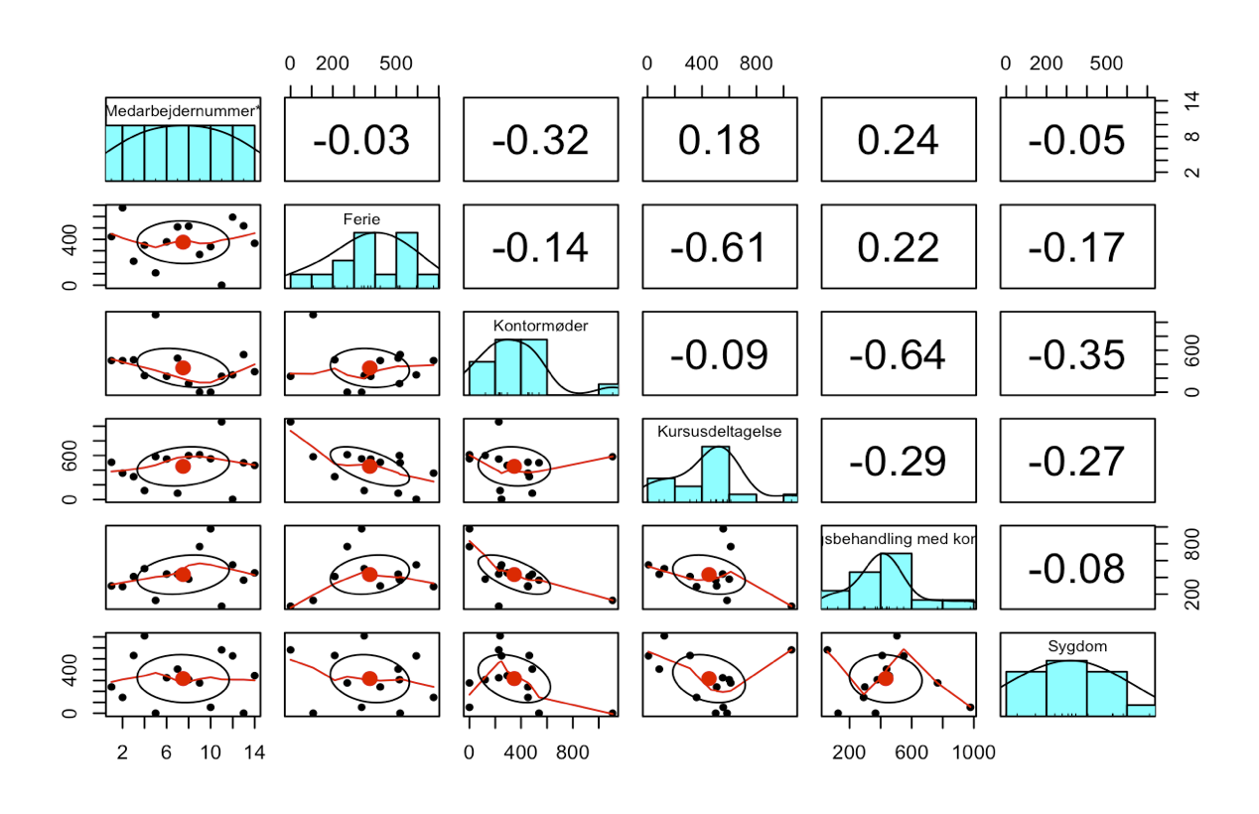
we can see that actual work time has a negative correlation with course and meetings which is
-.29 and -.64. work time and holiday has positive correlation which means if holiday increase work time also increase. The more you participate in the meeting the less employee can work.
Holiday and Course has negative correlation which is -.61 which means if one increase the other one decrease.
Seek and Meeting has negative correlation which is -.35

Slide 22
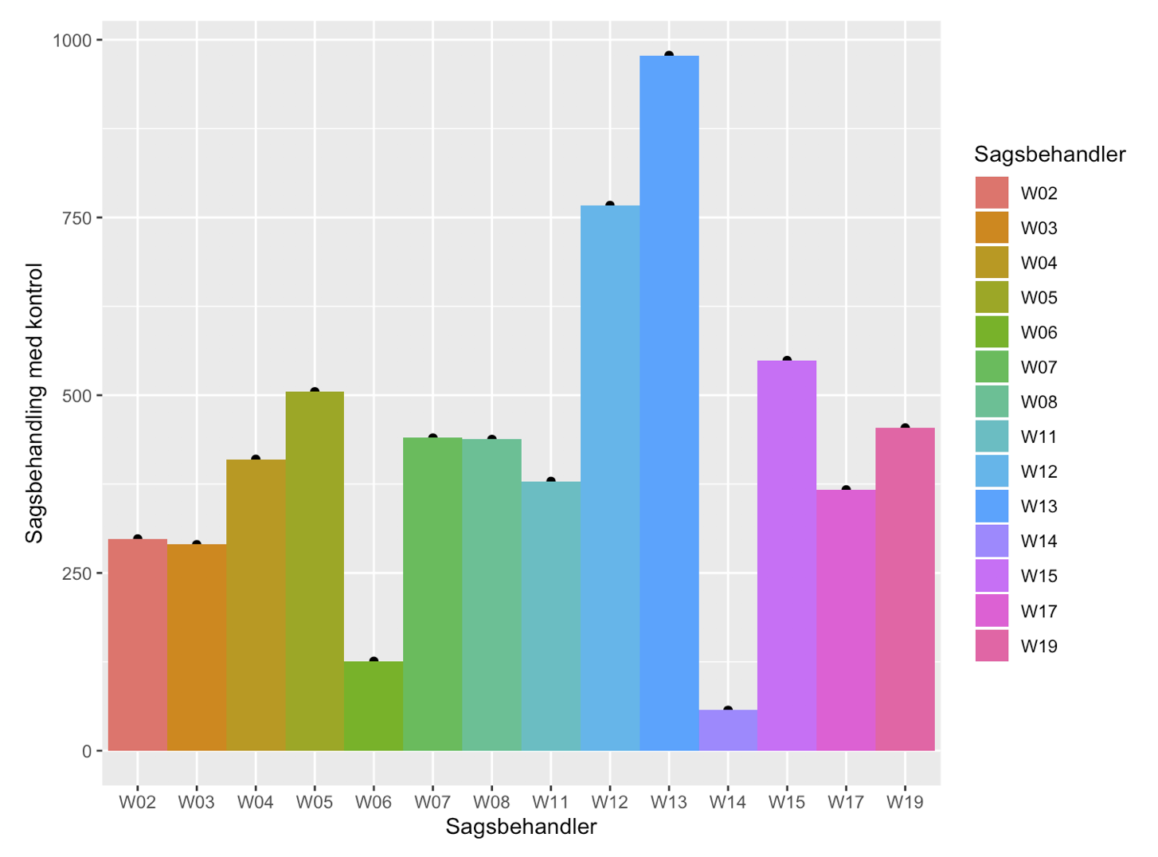
Actual work time spend by different employee

Slide 23
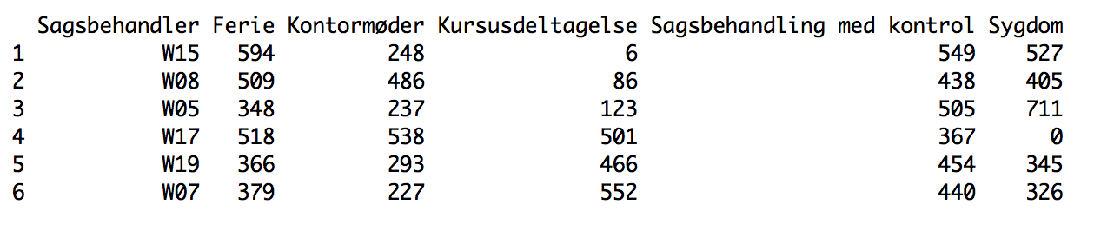
Top 6 case worker activity like holiday, meeting, course, work hour, sickness, all activities
are in hour.

Slide 24
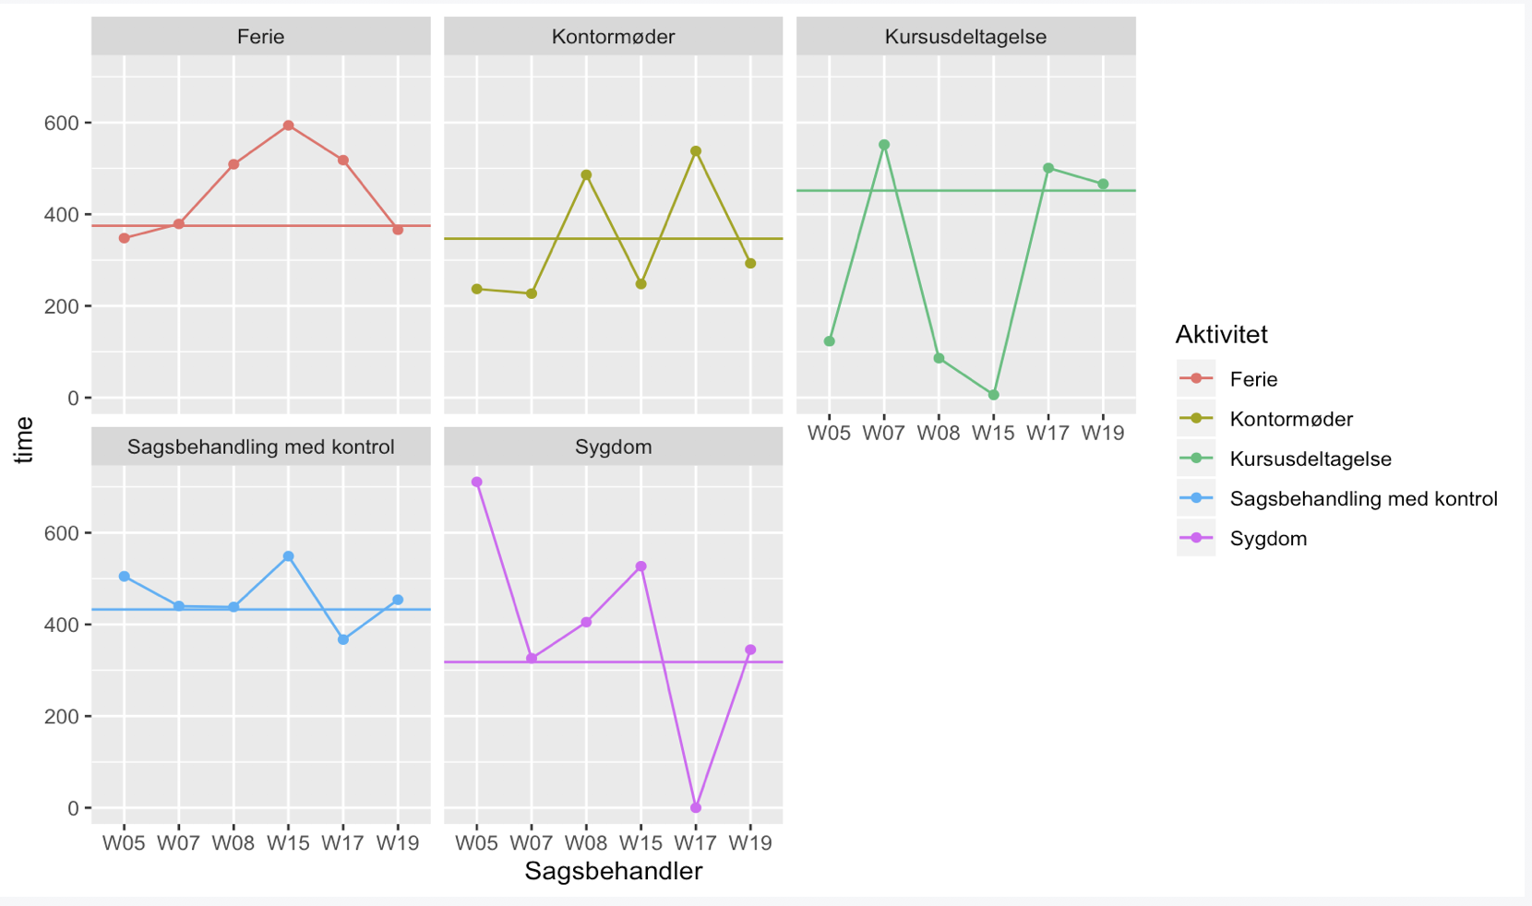
We can see that our top 6 employees work more then average work time. They also did less
course time then average and spend less meeting time then average

Slide 25
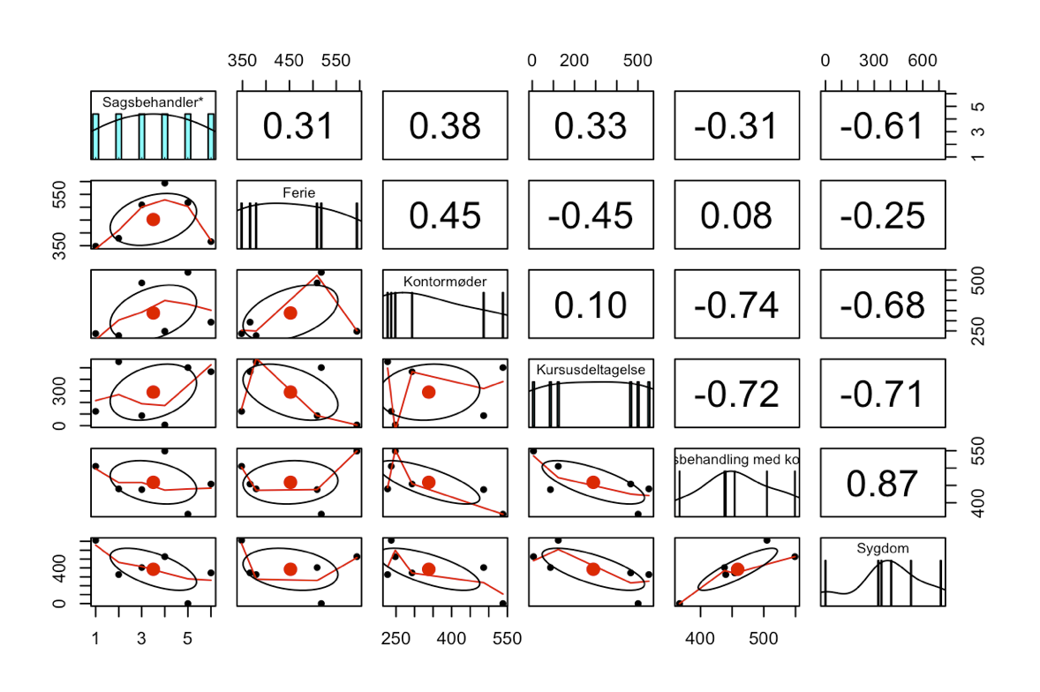
Top 6 employee correlation matrix. We can see that work time and the meeting has negative
correlation which is -.74 which means the more they do the meeting the less the work.
Same as taking Courses the more they take courses the less they can work.

Slide 26
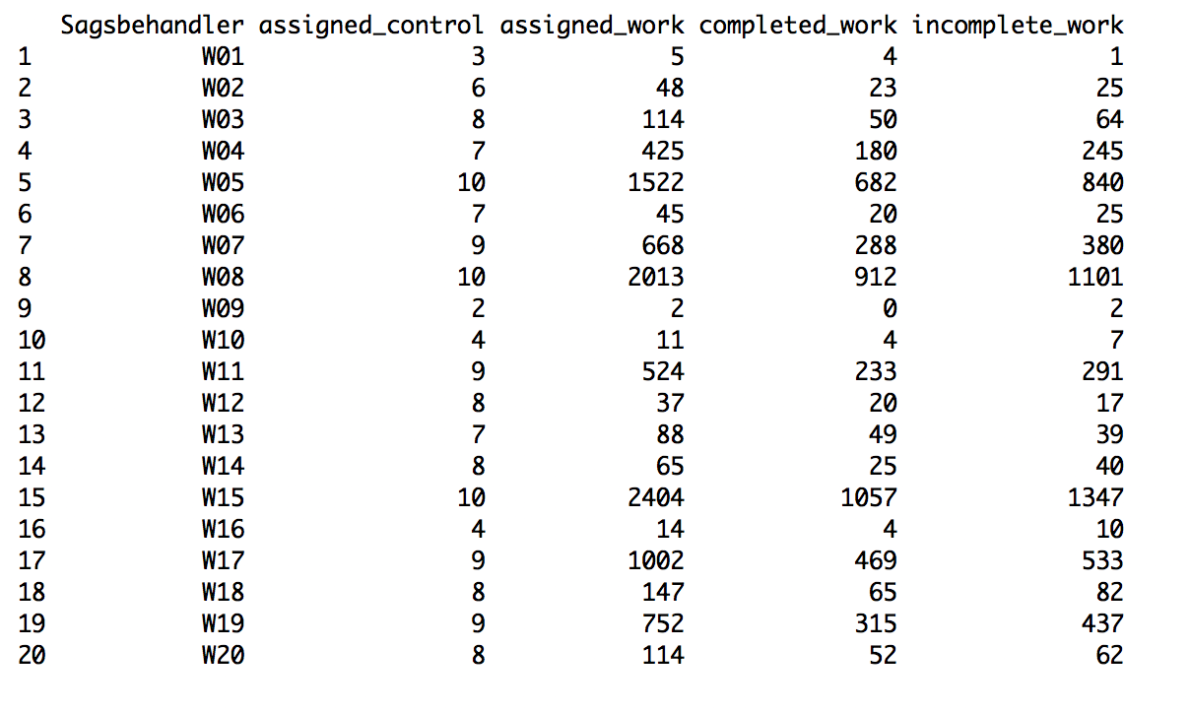
Each employee overview of control
Assigned control: Different type of control each employ capable to work.
Assigned work: Total amount of work assigned for each case worker.

Slide 27
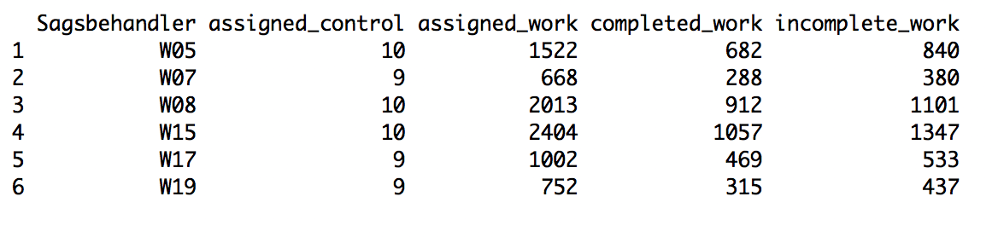
Here assigned control shows Top 6 Employee ability of different type of control
We can see that top 6 case worker who are responsible to collect 84% of total revenue
are able to work almost 10 type of control out of 10 control.

Slide 28
We can see from our small analysis that these 6 employees are the most skilled employees,
can work All types of control, that’s why they are responsible to collect most of the revenue.
Through proper training and course work, we can increase the rest of the employee's skills
so the task can be distributed to the rest of the employees as well.
To find more insight from the dataset we need to do more analysis.

